Slide 1
Aakash Goel https://www.linkedin.com/in/goelaakash123/
Session 9:
Image Classification
Acknowledgement: Slide Materials adopted from - Intro to Computer Vision (Cornell Tech); Noah Snavely, prepared by the lead instructor Prof S P Vimal , modified (added some content) by Aakash Goel

Slide 2
Topics
Image classification pipeline
Training, validation, testing
Nearest neighbor classification
Linear classification
Building up to… CNNs for learning, transformers and vision transformers (next class)
Acknowledgement: Slide Materials adopted from - Intro to Computer Vision (Cornell Tech); Noah Snavely, Fei-Fei Li, Justin Johnson, Serena Yeung

Slide 3
Motivation – Why Image Classification ?
✅ Real-Life Examples:
Classifying X-ray images as 'normal' or 'pneumonia’
Tagging photos: 'cat', 'dog', 'car’
Identifying defective vs. non-defective parts in manufacturing
Smart assistants recognizing household items
🎥 Analogy:
Imagine a toddler learning to distinguish a cat from a dog: by seeing many examples,and focusing on key visual features.

Slide 4
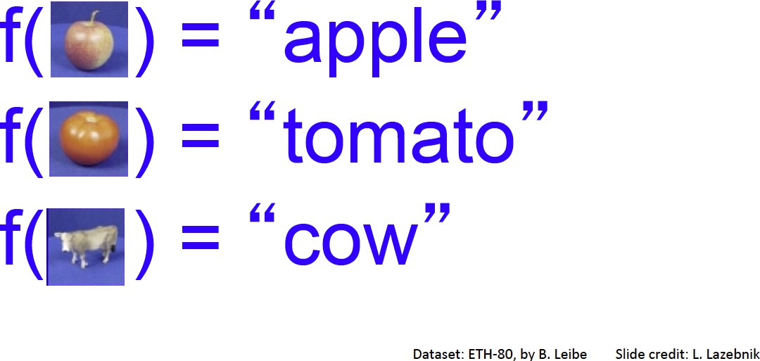
Image Classification:
A core task in Computer Vision
CV 9: Image Classification
Assume given set of discrete labels, e.g.
{cat, dog, cow, apple, tomato, truck, … }

Slide 5

Image classification demo
CV 9: Image Classification
https://cloud.google.com/vision/
See also: https://aws.amazon.com/rekognition/ https://www.clarifai.com/
https://azure.microsoft.com/en-us/services/cognitive-services/computer-vision/
…

Slide 6
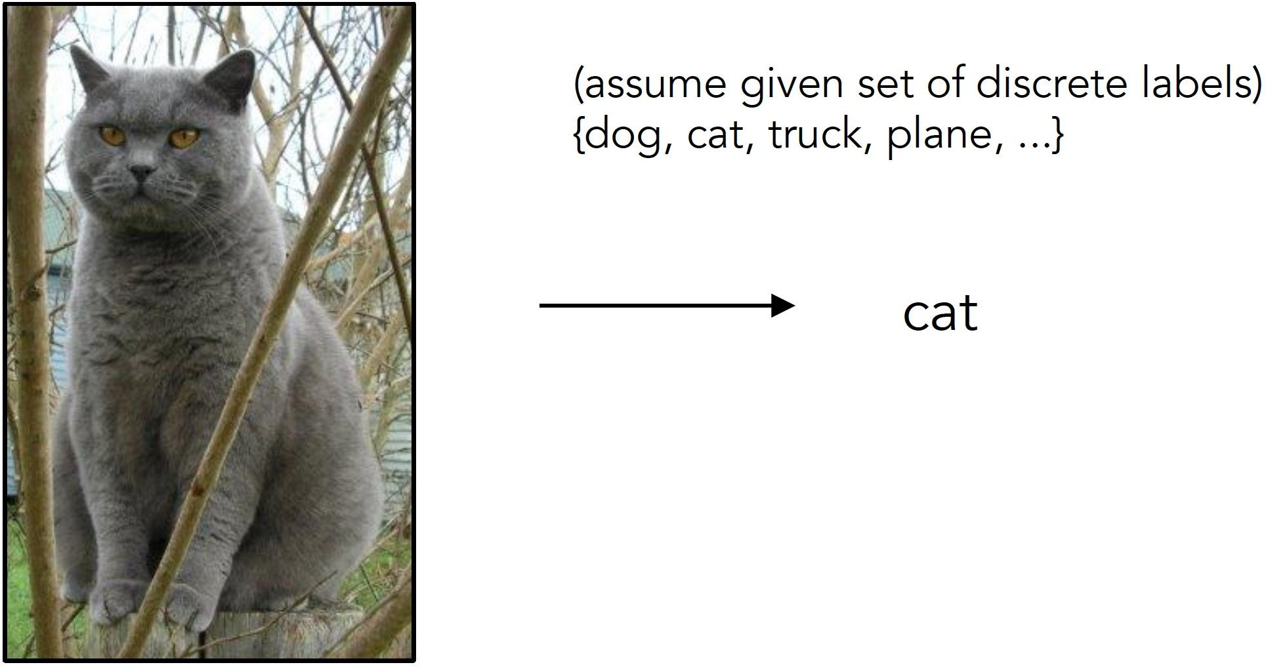
Image Classification
CV 9: Image Classification
Slides from Andrej Karpathy and Fei-Fei Li
http://vision.stanford.edu/teaching/cs231n/

Slide 7
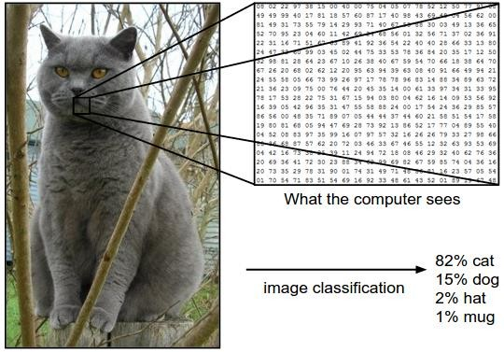
Image Classification: Problem
CV 9: Image Classification
The goal of image classification is to take this grid of numbers and determine what the image represents. In this case, the task is to classify the image as a "cat."
Instead of seeing the image as a whole, the computer sees a grid of numbers. These numbers represent pixel values, which encode information about the color and intensity of each part of the image.

Slide 8
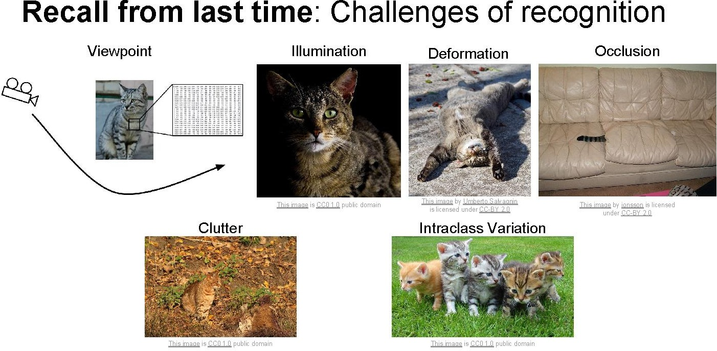
CV 9: Image Classification
Viewpoint: Cat viewed from the front looks different from a cat viewed from the side or above. Image classification models need to be robust to these changes in viewpoint.
Illumination: Lighting conditions can alter the appearance of an object.
Deformation: Objects can change shape or position, especially if they are flexible or articulated, like animals
Occlusion: Sometimes, parts of an object are hidden from view, either by other objects or by the object itself.
Clutter: The presence of other objects or a busy background can make it difficult to isolate the object of interest
Intraclass Variation: Even within the same category, there can be significant variation. Different breeds of cats, for example, can have different colors, sizes, and shapes.

Slide 9
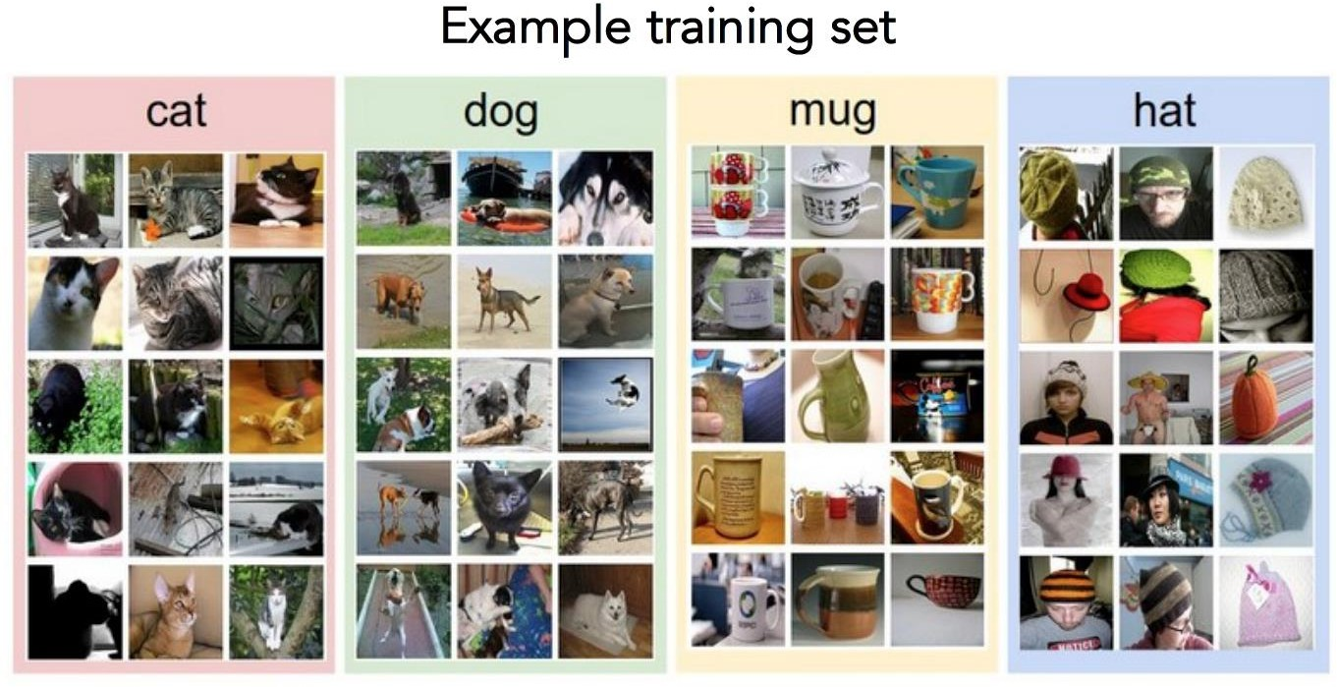
Data-driven approach
CV 9: Image Classification
Collect a database of images with labels
Use ML to train an image classifier
Evaluate the classifier on test images
Slides from Andrej Karpathy and Fei-Fei Li
http://vision.stanford.edu/teaching/cs231n/

Slide 10
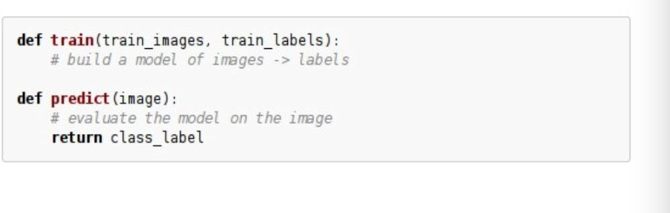
Data-driven approach
CV 9: Image Classification
Collect a database of images with labels
Use ML to train an image classifier - During this phase, the model processes the training images and adjusts its parameters to minimize the error between its predictions and the actual labels. This involves techniques like backpropagation and optimization algorithms such as gradient descent.
Evaluate the classifier on test images
Slides from Andrej Karpathy and Fei-Fei Li
http://vision.stanford.edu/teaching/cs231n/

Slide 11
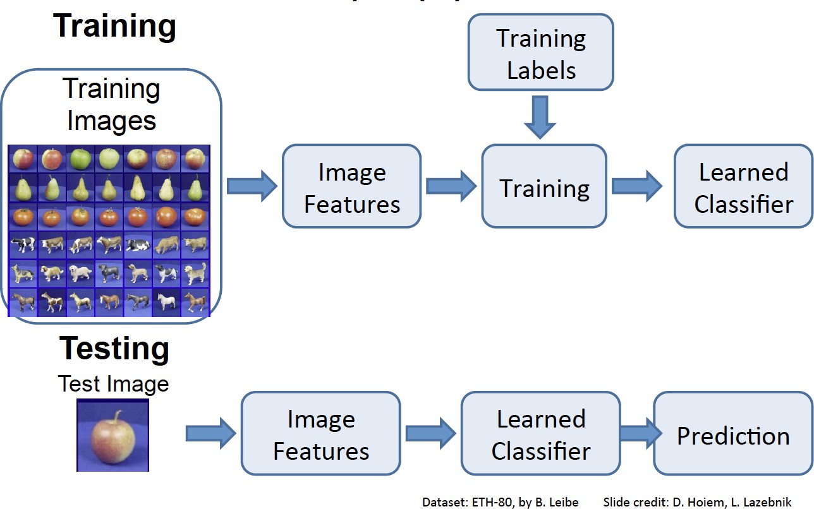
CV 9: Image Classification
The next step involves extracting features from the training images. Features are distinctive attributes or patterns that help differentiate one class from another. In traditional computer vision, this might involve techniques like edge detection or color histograms.
In modern deep learning approaches, convolutional neural networks (CNNs) automatically learn hierarchical features from raw pixel data, capturing complex patterns and structures.
The model learns to map features to labels by adjusting its parameters to minimize the error between its predictions and the actual labels.

Slide 12
CV 9: Image Classification

Slide 13
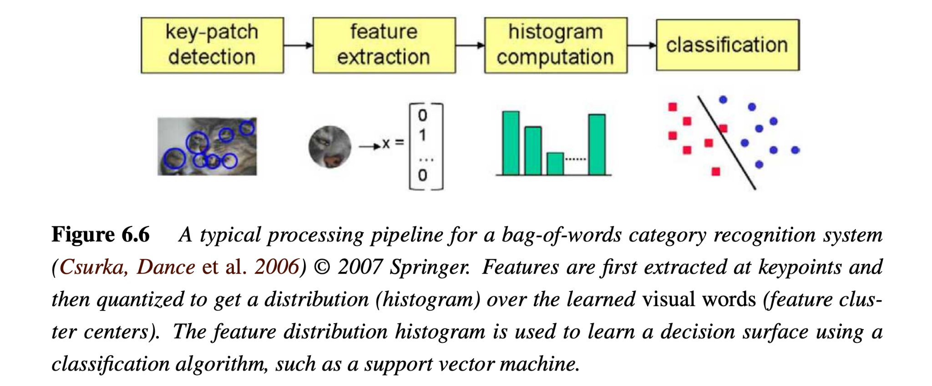
Bag of Words - classic approach
CV 9: Image Classification
Computer Vision: Algorithms and Applications, 2nd ed.
Notes:
Key-Patch: These are specific areas of interest that are likely to contain important information for distinguishing between different categories.
Feature Extraction: Once key patches are detected, features are extracted from these areas. These features are numerical representations that capture the essence of the key patches.
Extracted features are then quantized into a set of "visual words," similar to how words are used in text analysis. This involves clustering the features into a predefined number of clusters, each representing a visual word. → More detail -- lustering the features extracted from a large set of training images into a predefined number of clusters. Each cluster center represents a "visual word.“ The choice of the number of clusters (i.e., the size of the vocabulary) is an important parameter. A larger vocabulary can capture more detail but may also increase computational complexity.
Feature Vector Representation: The histogram is a fixed-length vector, regardless of the size or content of the image, because it is based on the predefined visual vocabulary. Each element of the vector represents the count (or normalized count) of a specific visual word in the image. This vector captures the distribution of features in the image.
Input to Classifier: The histogram feature vector is used as input to a machine learning classifier. Common choices for classifiers in the BoW model include Support Vector Machines (SVMs), k-Nearest Neighbors (k-NN), or even simple linear classifiers. The classifier is trained on these feature vectors, along with their corresponding labels, to learn decision boundaries that separate different classes.

Slide 14
Classifiers
CV 9: Image Classification
Nearest Neighbor
kNN (“k-Nearest Neighbors”)
Linear Classifier
Neural Network
Deep Neural Network
…

Slide 15
First: Nearest Neighbor (NN) Classifier
CV 9: Image Classification
Train
Remember all training images and their labels
Predict
Find the closest (most similar) training image
Predict its label as the true label

Slide 16
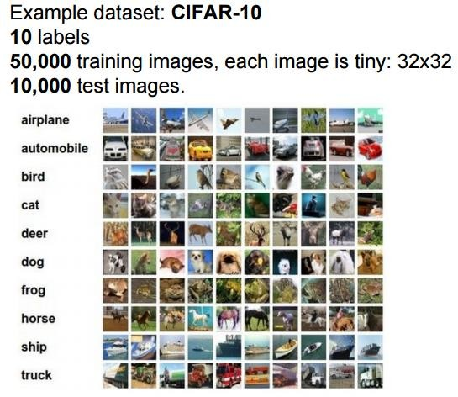
CIFAR-10 and NN results
CV 9: Image Classification

Slide 17
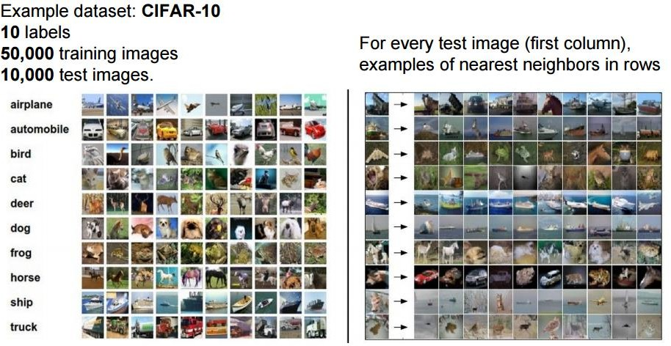
CIFAR-10 and NN results
CV 9: Image Classification
Slides from Andrej Karpathy and Fei-Fei Li
http://vision.stanford.edu/teaching/cs231n/

Slide 18
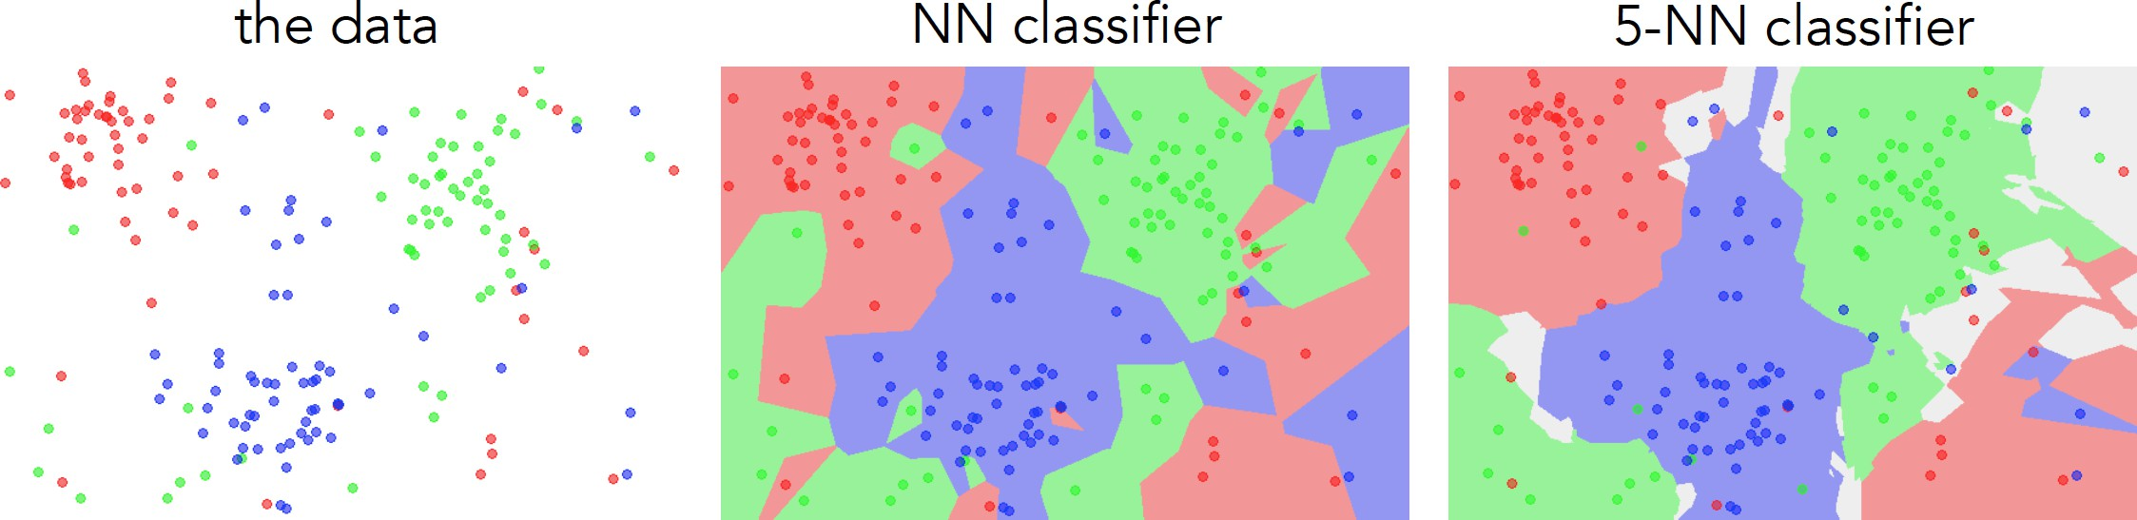
k-nearest neighbor
CV 9: Image Classification
Find the k closest points from training data
Take majority vote from K closest points

Slide 19
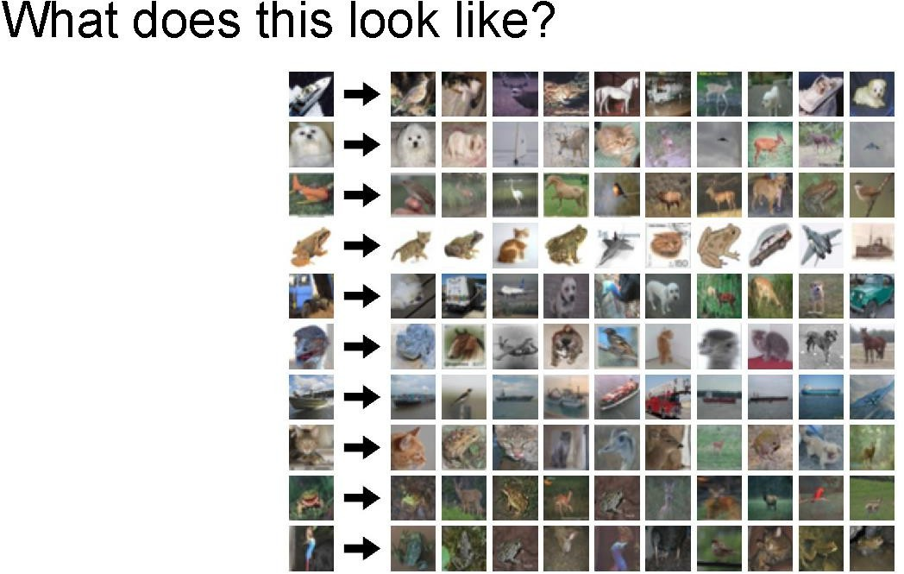
CV 9: Image Classification

Slide 20
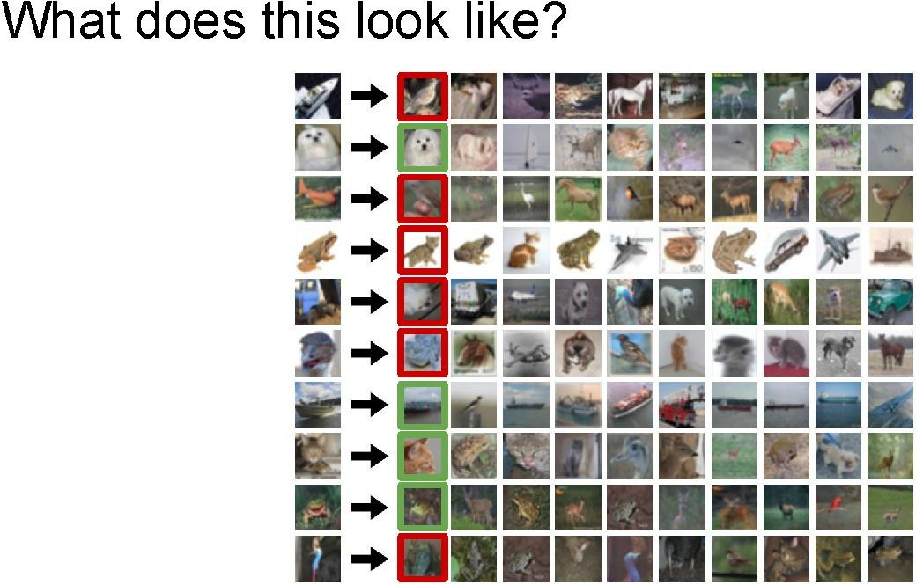

Slide 21
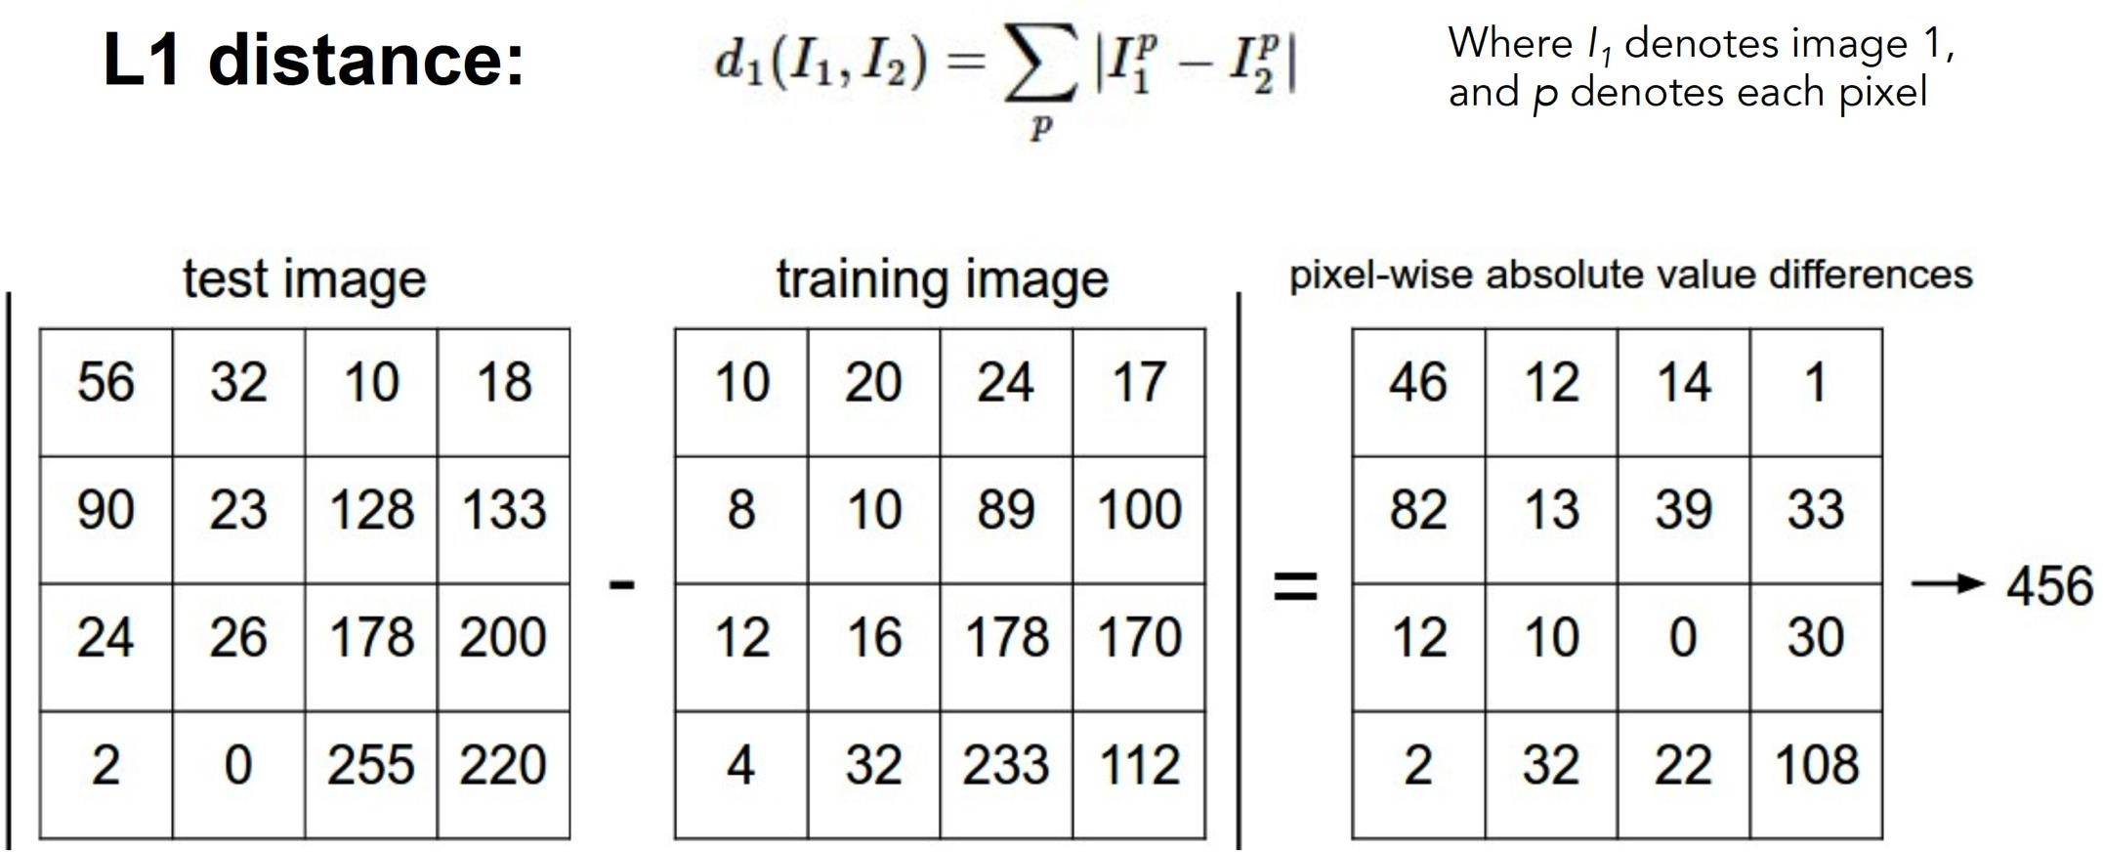
How to find the most similar training image? What is the distance metric?
CV 9: Image Classification
Slides from Andrej Karpathy and Fei-Fei Li
http://vision.stanford.edu/teaching/cs231n/

Slide 22
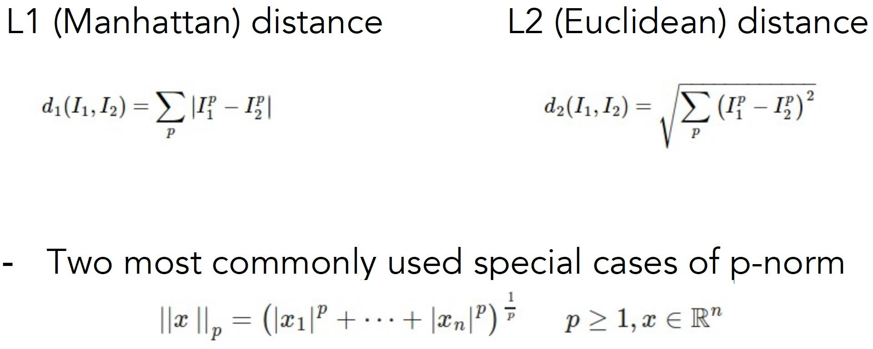
Choice of distance metric
CV 9: Image Classification
Hyperparameter
Slides from Andrej Karpathy and Fei-Fei Li
http://vision.stanford.edu/teaching/cs231n/

Slide 23
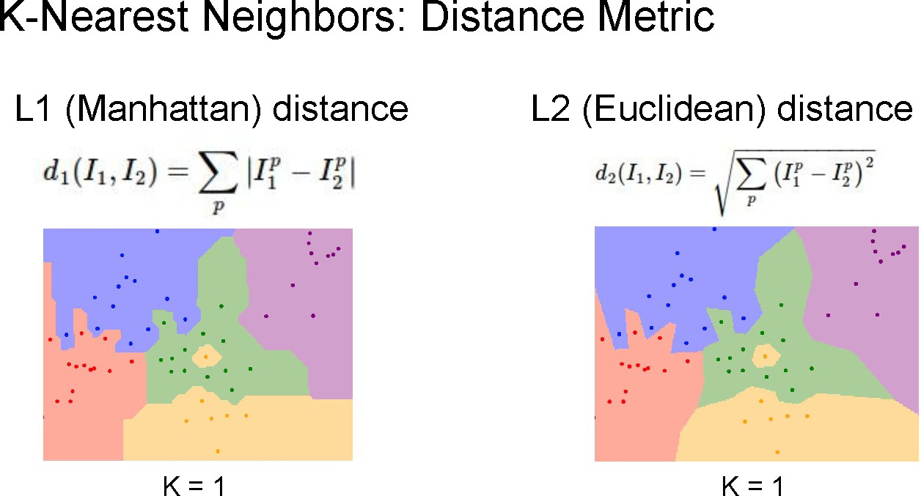
CV 9: Image Classification
Demo: http://vision.stanford.edu/teaching/cs231n-demos/knn/

Slide 24
Hyperparameters
CV 9: Image Classification
What is the best distance to use?
What is the best value of k to use?
These are hyperparameters: choices about the algorithm that we set rather than learn
How do we set them?
– One option: try them all and see what works best

Slide 25
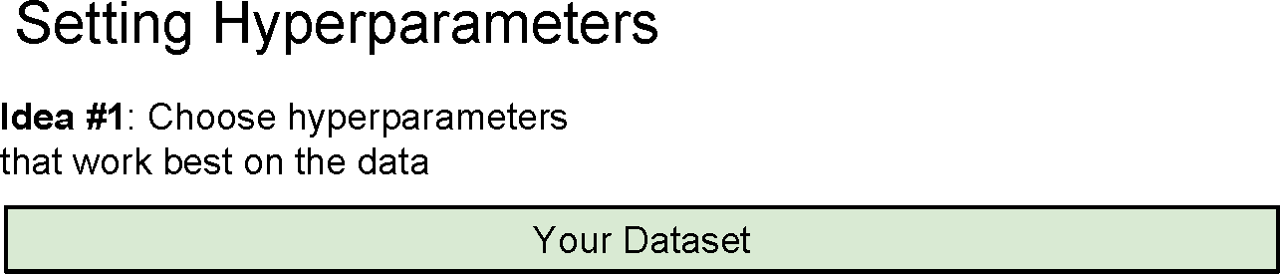
CV 9: Image Classification

Slide 26
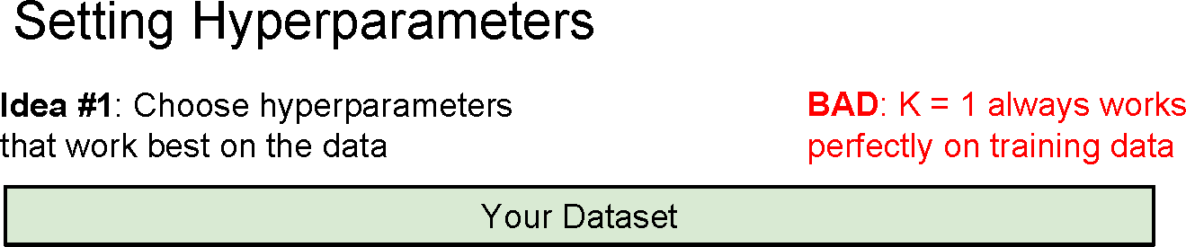
CV 9: Image Classification

Slide 27
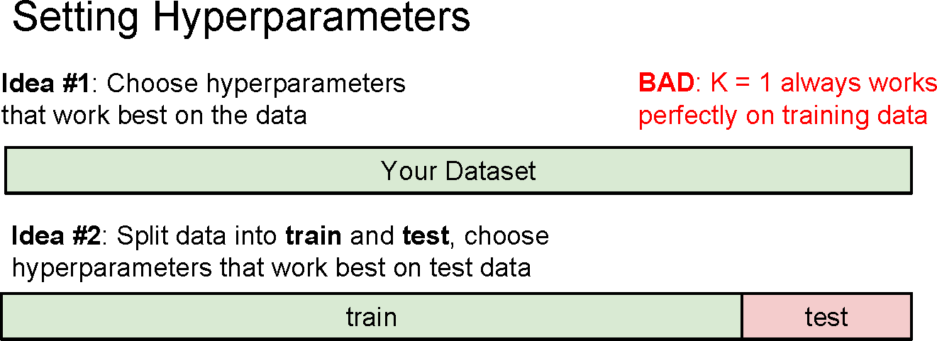
CV 9: Image Classification

Slide 28
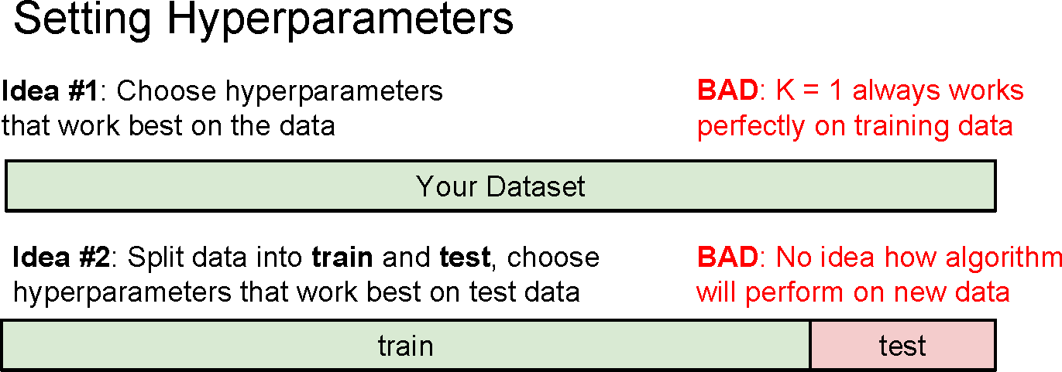
CV 9: Image Classification

Slide 29
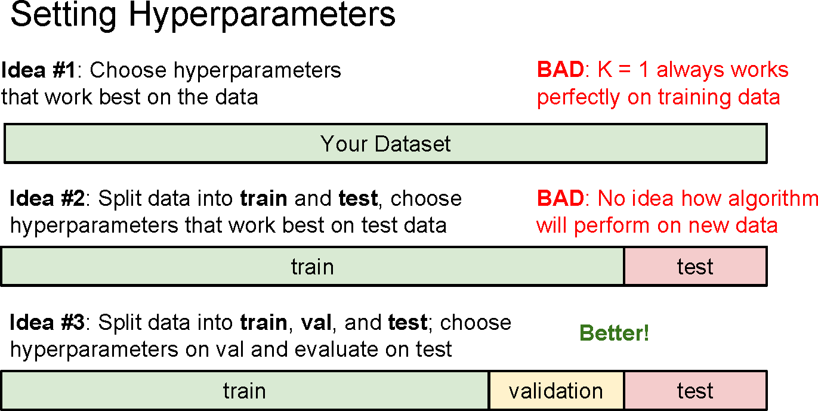
CV 9: Image Classification

Slide 30
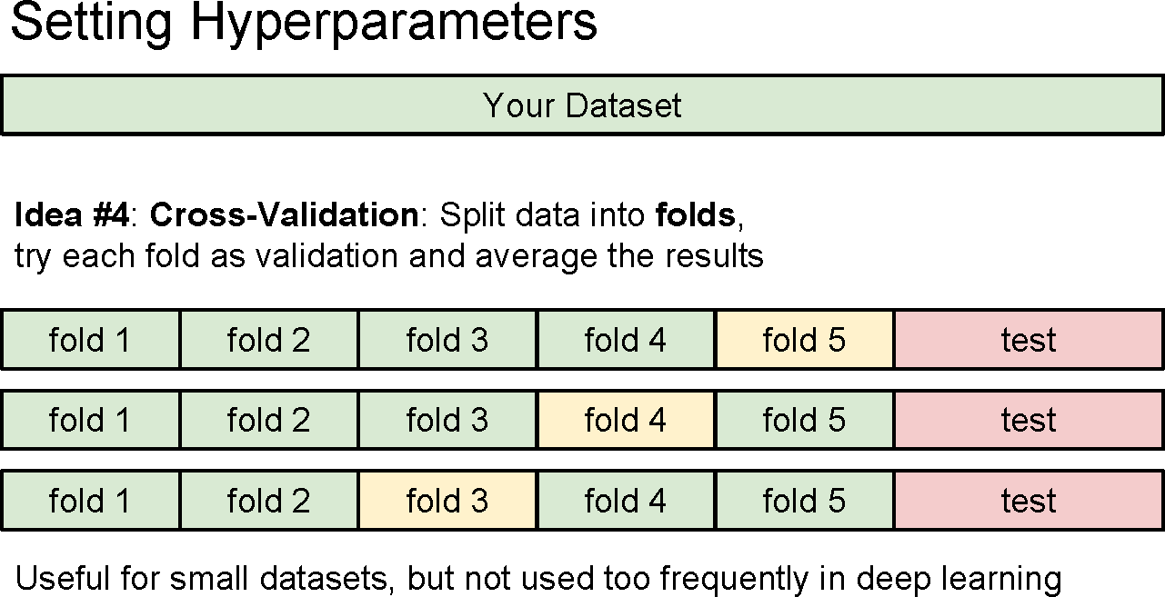
CV 9: Image Classification

Slide 31
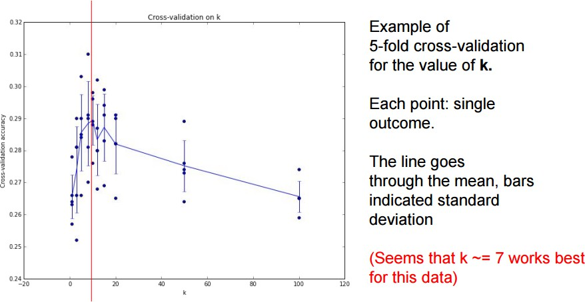
CV 9: Image Classification

Slide 32
Recap: How to pick hyperparameters?
CV 9: Image Classification
Methodology
Train and test
Train, validate, test
Train for original model
Validate to find hyperparameters
Test to understand generalizability

Slide 33
kNN -- Complexity and Storage
CV 9: Image Classification
N training images, M test images
Training: O(1)
Testing: O(MN)
Hmm…
Normally need the opposite
Slow training (ok), fast testing (necessary)

Slide 34
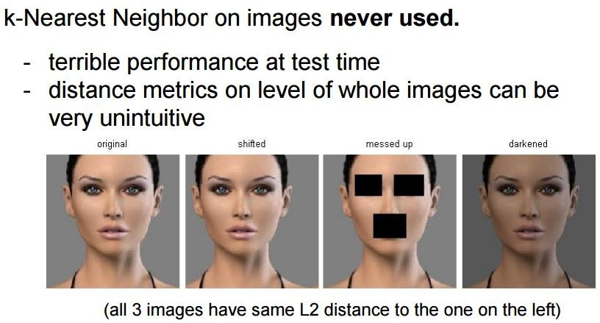
CV 9: Image Classification
Notes:
This approach does not account for spatial relationships or perceptual differences, focusing solely on numerical differences in pixel values.
shifting an image might change the pixel values uniformly across the image, while darkening might reduce pixel values by a constant amount. Both transformations can lead to similar L2 distances if the overall change in pixel values is consistent.
L2 distance does not consider the spatial arrangement of pixels. It treats the image as a flat vector, ignoring how pixels are organized or how changes in one part of the image might affect perception.

Slide 35
k-Nearest Neighbors: Summary
CV 9: Image Classification
In image classification we start with a training set of images and labels, and must predict labels on the test set
The K-Nearest Neighbors classifier predicts labels based on nearest training examples
Distance metric and K are hyperparameters
Choose hyperparameters using the validation set; only run on the test set once at the very end!

Slide 36
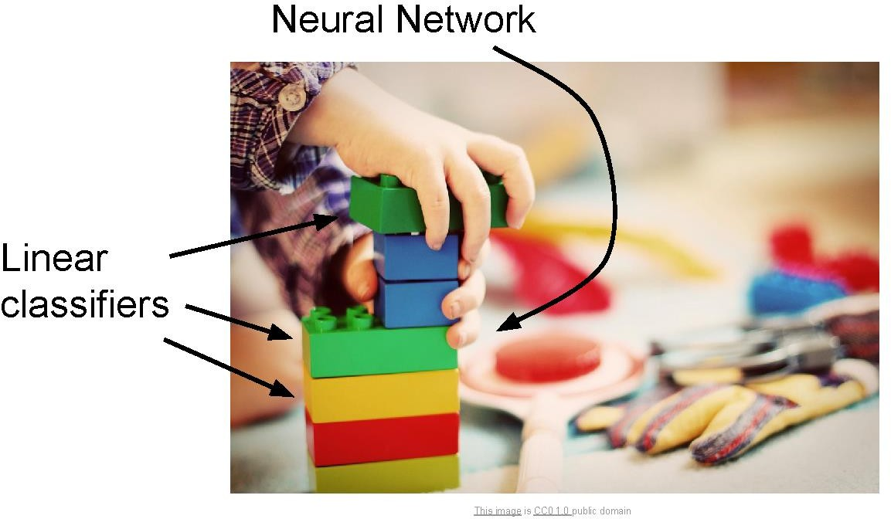
Linear classifiers
CV 9: Image Classification

Slide 37
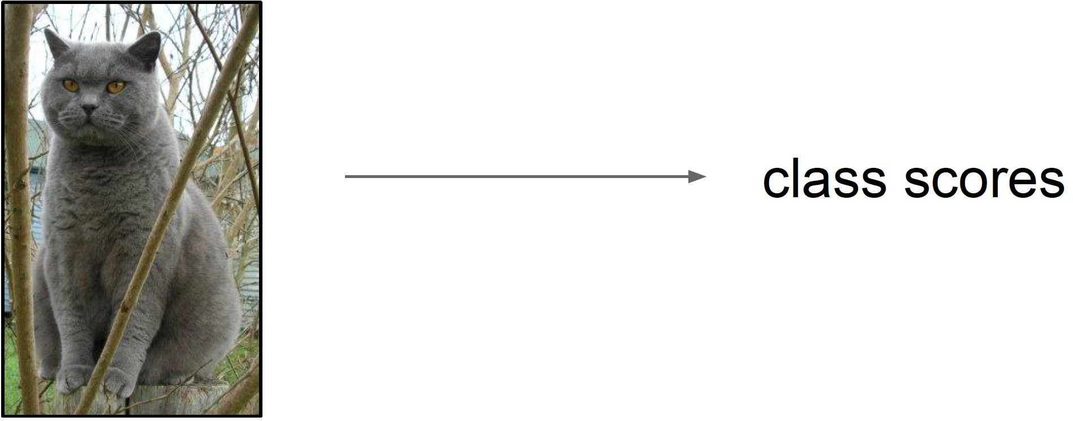
Score function
CV 9: Image Classification
Slides from Andrej Karpathy and Fei-Fei Li
http://vision.stanford.edu/teaching/cs231n/

Slide 38
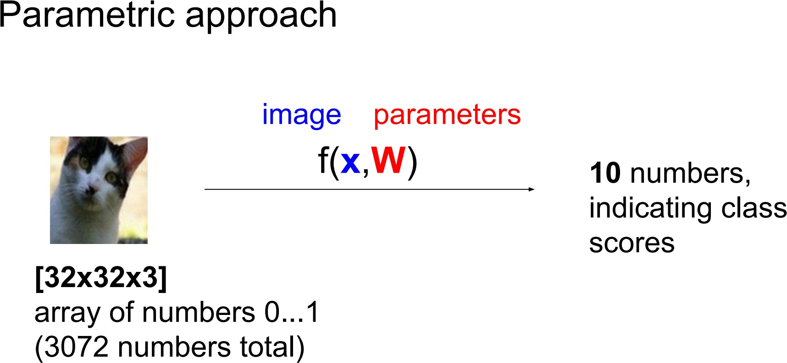
Score function: f
CV 9: Image Classification

Slide 39
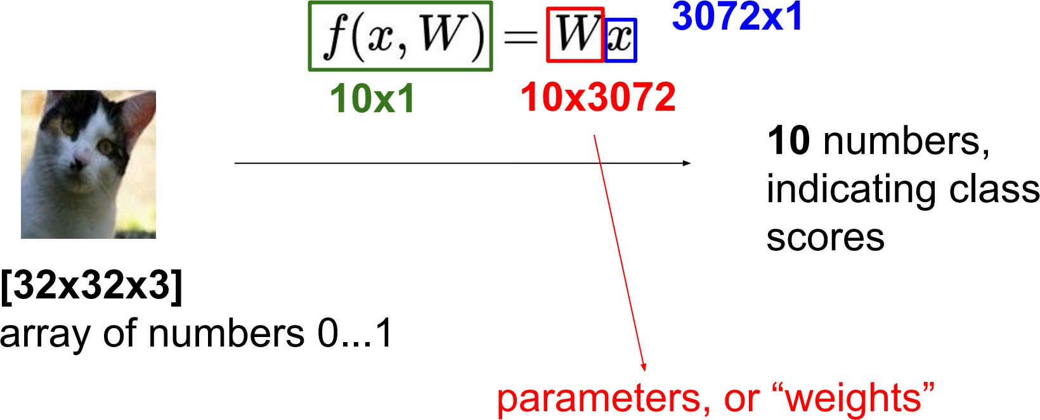
Parametric approach: Linear classifier
CV 9: Image Classification

Slide 40
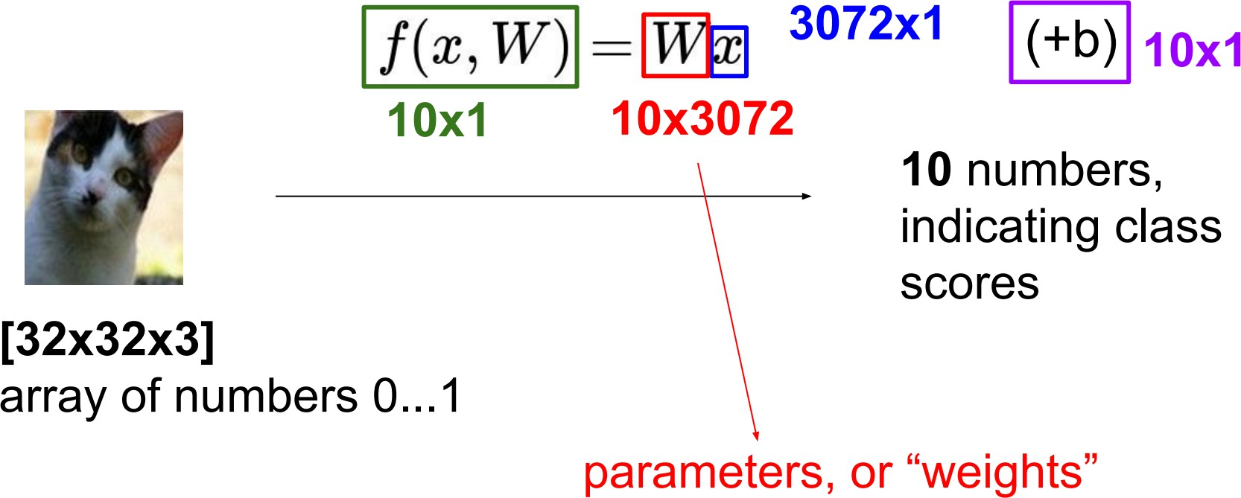
Parametric approach: Linear classifier
CV 9: Image Classification

Slide 41
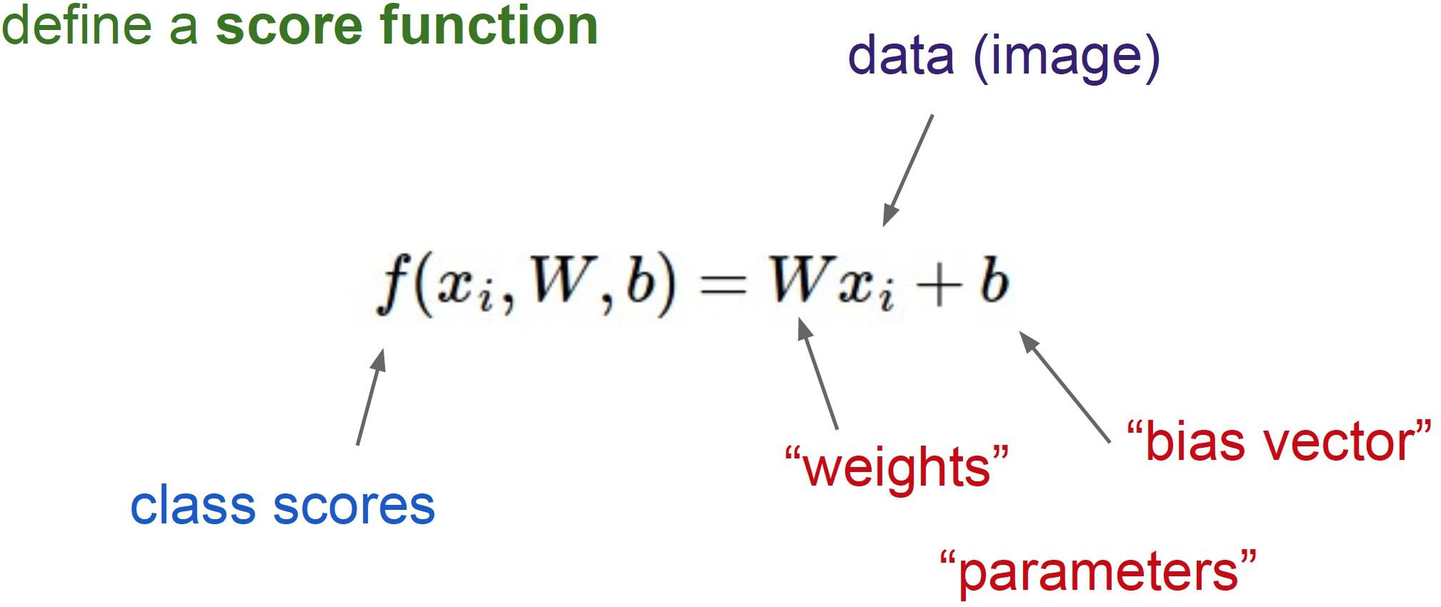
Linear Classifier
CV 9: Image Classification

Slide 42
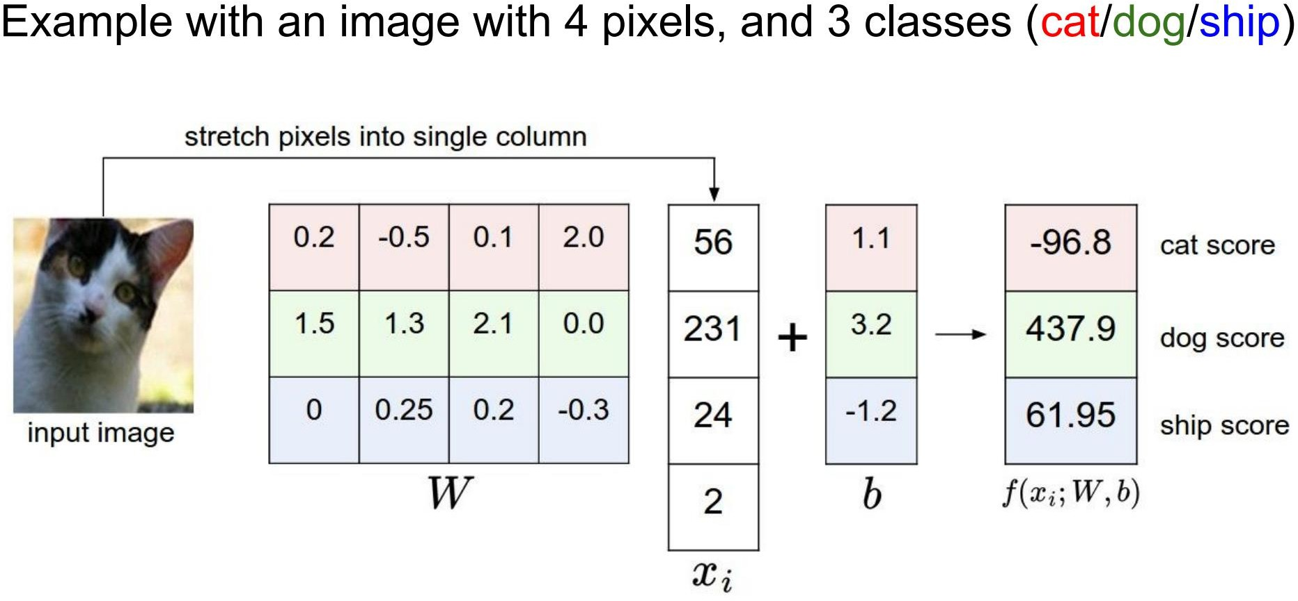
CV 9: Image Classification

Slide 43

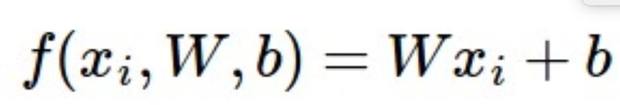
Interpretation: Template matching
CV 9: Image Classification

Slide 44
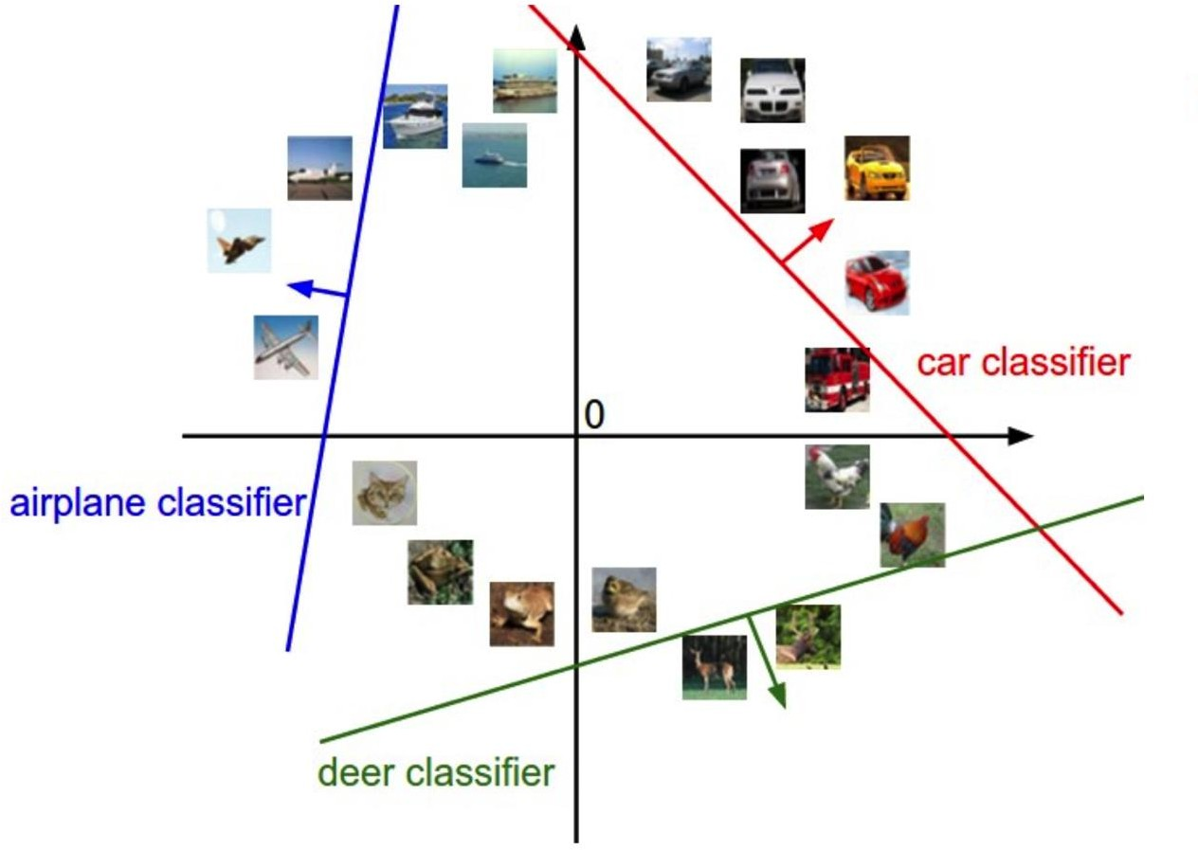
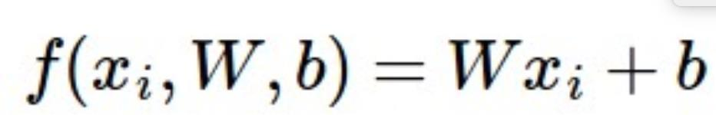
Geometric Interpretation
CV 9: Image Classification

Slide 45




Linear classifiers
CV 9: Image Classification
Find linear function (hyperplane) to separate positive and negative examples
x_{i} positive :
x_{i} negative :
x_{i} ⋅ w + b ≥ 0
x_{i} ⋅ w + b < 0
Which hyperplane is best? We will come back to this later

Slide 46
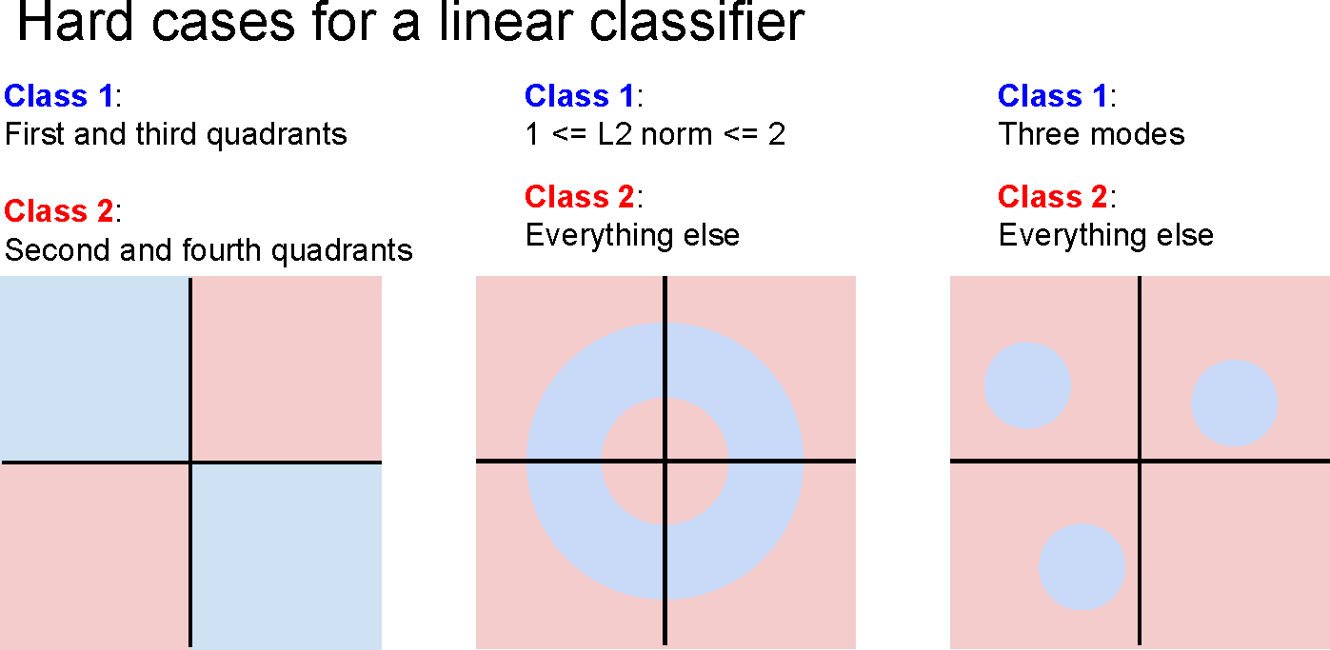
CV 9: Image Classification

Slide 47
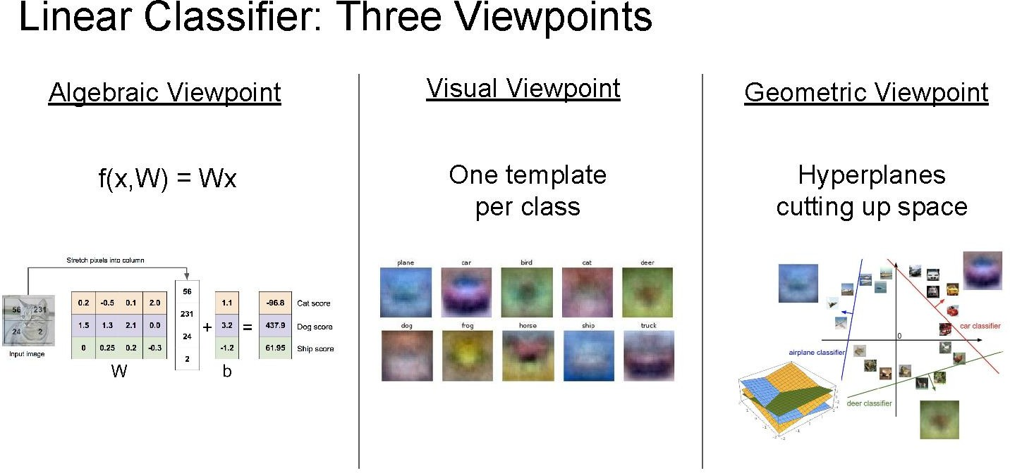
CV 9: Image Classification

Slide 48
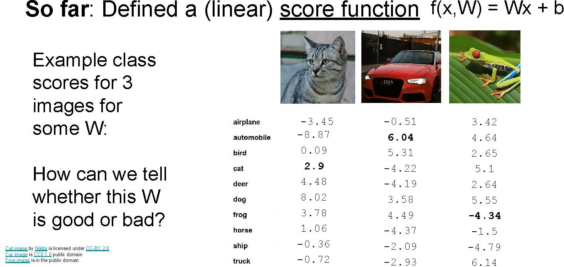
CV 9: Image Classification

Slide 49
Recap
CV 9: Image Classification
Learning methods
k-Nearest Neighbors
Linear classification
Classifier outputs a score function giving a score to each class
how do we define how good a classifier is based on the training data? (Spoiler: define a loss function)

Slide 50
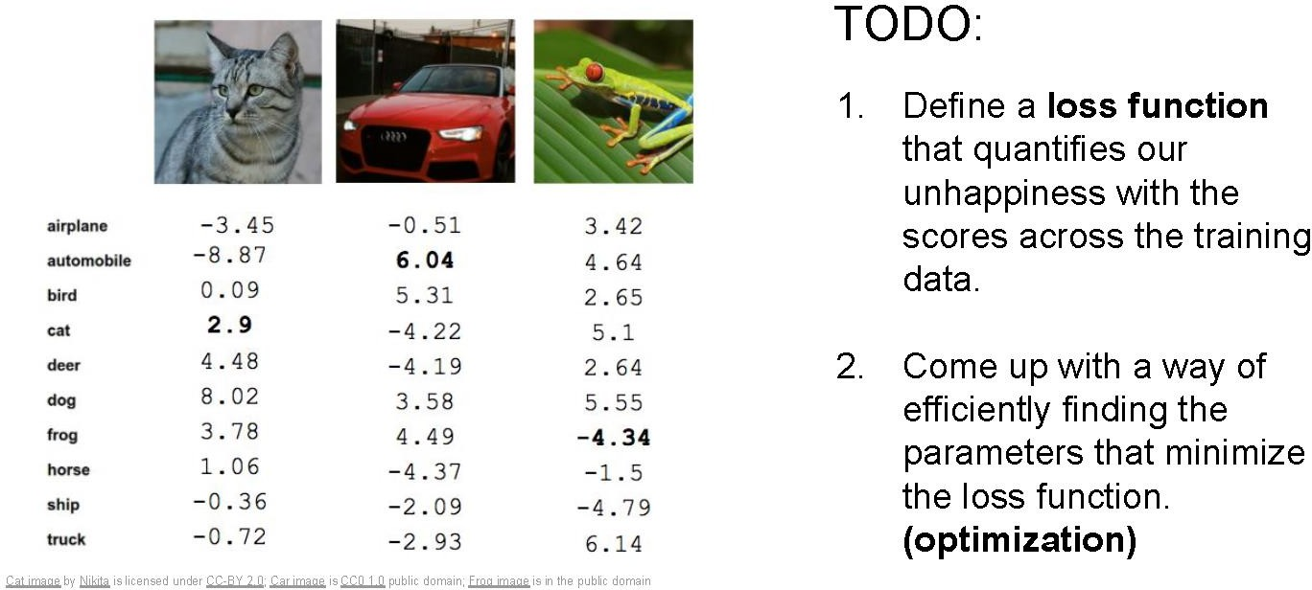
Linear classification
CV 9: Image Classification
Output scores

Slide 51
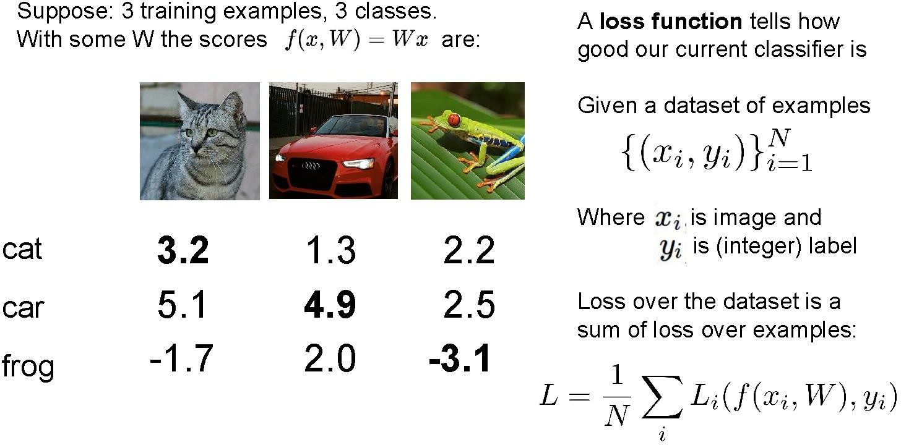
CV 9: Image Classification

Slide 52
Loss function, cost/objective function
CV 9: Image Classification
Given ground truth labels (y_{i}), scores f(x_{i}, W)
– how unhappy are we with the scores?
Loss function or objective/cost function measures unhappiness
During training, want to find the parameters W that minimizes the loss function

Slide 53
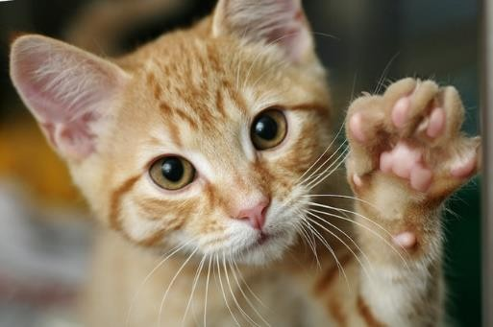
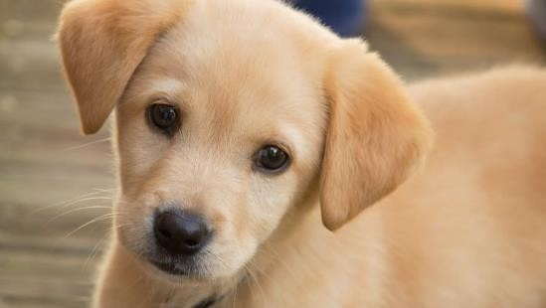

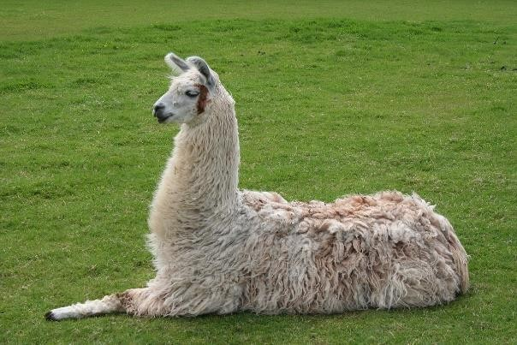
Simpler example: binary classification
CV 9: Image Classification
Two classes (e.g., “cat” and “not cat”)
– AKA “positive” and “negative” classes
cat
not cat

Slide 54
Linear classifiers
CV 9: Image Classification
Find linear function (hyperplane) to separate positive and negative examples
x_{i} positive :
x_{i} negative :
x_{i} ⋅ w + b ≥ 0
x_{i} ⋅ w + b < 0
Which hyperplane is best? We need a loss function to decide

Slide 55
What is a good loss function?
CV 9: Image Classification
One possibility
– Number of misclassified examples
Loss: 2
Loss: 0
Loss: 0
Problems: discrete, can’t break ties
We want the loss to lead to good generalization
We want the loss to work for more than 2 classes

Slide 56
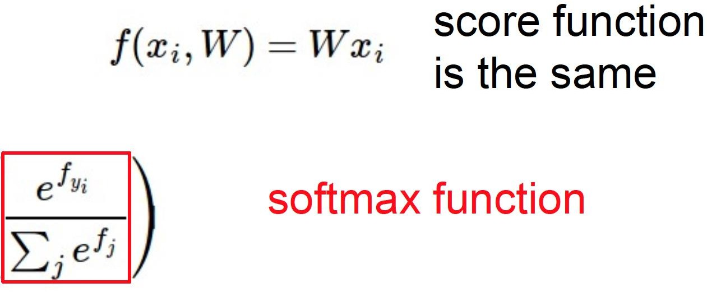
Softmax classifier
CV 9: Image Classification
(score function)
Example with three classes:
Interpretation: squashes values into
probabilities ranging from 0 to 1

Slide 57
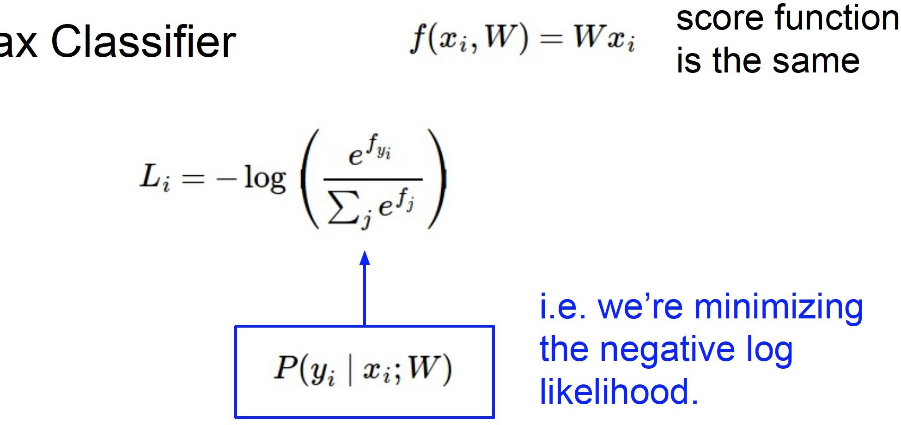

Cross-entropy loss
CV 9: Image Classification
(score function)

Slide 58
Losses
CV 9: Image Classification
Cross-entropy loss is just one possible loss function
One nice property is that it reinterprets scores as probabilities, which have a natural meaning
SVM (max-margin) loss functions also used to be popular
But currently, cross-entropy is the most common classification loss

Slide 59
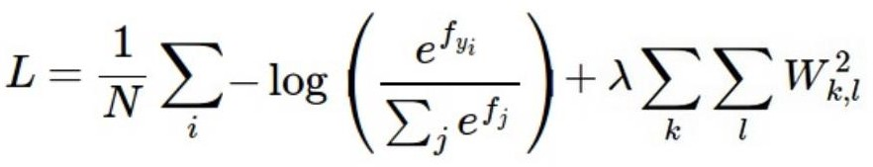
Summary
CV 9: Image Classification
Have score function and loss function
Currently, score function is based on linear classifier
Next, will generalize to convolutional neural networks
Find W and b to minimize loss

Slide 60
Additional Readings and References:
Stanford CS231N
– http://cs231n.stanford.edu/
https://www.cs.toronto.edu/~kriz/cifar.html
Hands on
https://github.com/mithunkumarsr/LearnComputerVisionWithMithun/blob/main/CV9_Image_Classification.ipynb

Slide 61
Thank you

